Slide 1


ACCT 2003 Intermediate Financial Accounting 中级财务会计
THE HITSZ
SCHOOL OF ECONOMICS
AND MANAGEMENT
授课人：墙伟
2024.9.11

Slide 2

LEARNING OBJECTIVES
CHAPTER 9
Inventories:
Additional Valuation Issues
After studying this lecture, you should be able to:
Describe and apply the lower-of-cost-or-net realizable value rule.
Explain how to report and analyze inventory.

Slide 3
LEARNING OBJECTIVE 1
Describe and apply the lower-of-cost-or-net realizable value rule.

Slide 4
Lower-of-Cost-or-Net Realizable Value (LCNRV) 成本和可变现净值孰低
A company abandons the historical cost principle when the future utility (revenue-producing ability) of the asset drops below its original cost.
Net Realizable Value 可变现净值
Estimated selling price in the normal course of business less
estimated costs to complete and
estimated costs to make a sale.
LO 1
Notes:
Inventories are recorded at their cost. However, if inventory declines in value below its original cost, a major departure from the historical cost principle occurs. Whatever the reason for a decline—obsolescence, price-level changes, or damaged goods—a company should write down the inventory to net realizable value to report this loss.
The term net realizable value (NRV) refers to the net amount that a company expects to realize from the sale of inventory.

Slide 5
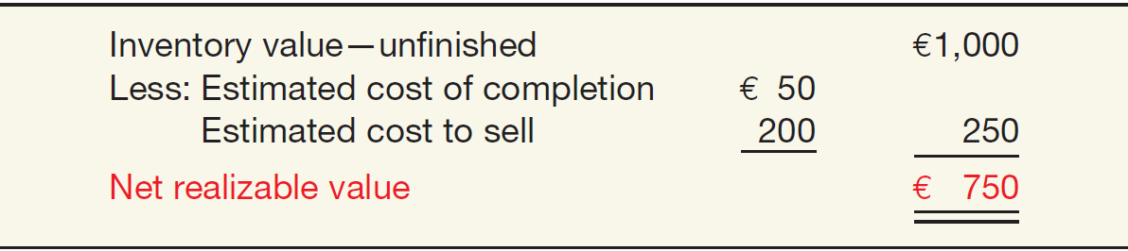
Net Realizable Value 可变现净值
Illustration: Assume that Mander AG has unfinished inventory with a cost of €950, a sales value of €1,000, estimated cost of completion of €50, and estimated selling costs of €200. Mander’s net realizable value is computed as follows.
ILLUSTRATION 9.1
Computation of Net Realizable Value
LO 1
Notes:
Mander reports inventory on its statement of financial position at €750. In its income statement, Mander reports a Loss on Inventory Write-Down of €200 (€950 − €750).

Slide 6
Net Realizable Value 可变现净值
ILLUSTRATION 9.1
Computation of Net Realizable Value
Mander reports inventory 存货 on its balance sheet at €750.
In its income statement, Mander reports a Loss on Inventory Write-Down 存货减值损失 of €200 (€950 − €750).
LO 1
Notes:
A departure from cost is justified because inventories should not be reported at amounts higher than their expected realization from sale or use. In addition, a company like Mander should charge the loss of utility against revenues in the period in which the loss occurs, not in the period of sale.

Slide 7
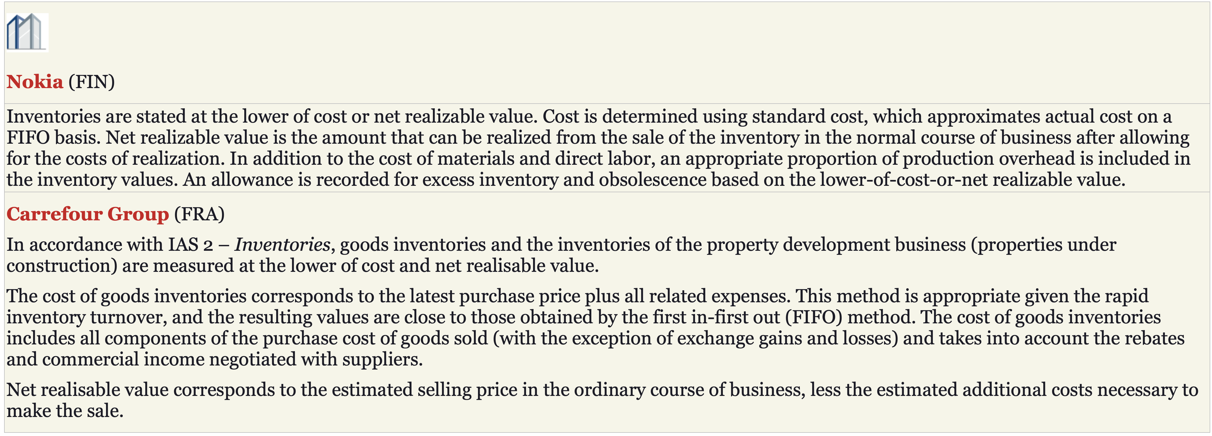
Net Realizable Value 可变现净值
Companies therefore report their inventories at the lower-of-cost-or-net realizable value (LCNRV) at each reporting date.
ILLUSTRATION 9.2
LCNRV Disclosures
LO 1
Notes:
Companies therefore report their inventories at the lower-of-cost-or-net realizable value (LCNRV) at each reporting date. Illustration 9.2 shows how two companies indicate measurement at LCNRV.

Slide 8
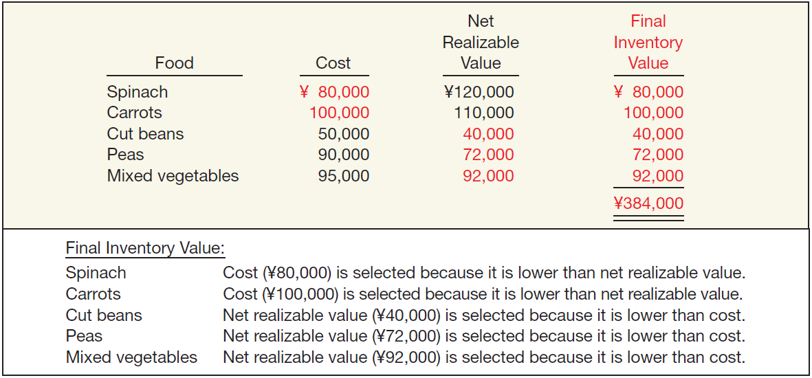
Illustration of LCNRV
Jinn-Feng Foods computes its inventory at LCNRV (amounts in thousands).
ILLUSTRATION 9.3
Determining Final Inventory Value
LO 1
Notes:
A company estimates net realizable value based on the most reliable evidence of the inventories’ realizable amounts (expected selling price, expected costs of completion, and expected costs to sell).
As indicated, the final inventory value of ¥384,000 equals the sum of the LCNRV for each of the inventory items. That is, Jinn-Feng applies the LCNRV rule to each individual type of food.
spin‧ach /ˈspɪnɪdʒ, -ɪtʃ/

Slide 9
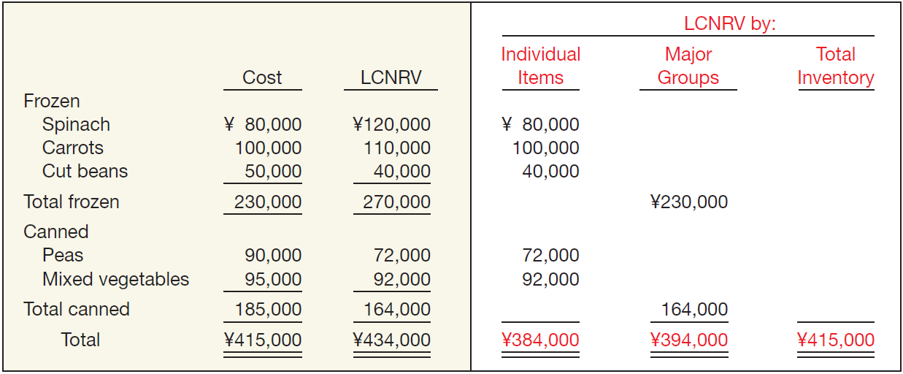
Methods of Applying LCNRV
Assume that Jinn-Feng Foods separates its food products into two major groups, frozen and canned.
ILLUSTRATION 9.4
Alternative Applications of LCNRV
LO 1
Notes:
In the Jinn-Feng Foods illustration, we assumed that the company applied the LCNRV rule to each individual type of food. However, companies may apply the LCNRV rule to a group of similar or related items, or to the total of the inventory. For example, in the textile industry, sometimes it is not possible to determine selling price for each textile individually, and therefore, it may be necessary to perform the net realizable value assessment on all textiles that will be used to produce clothing for a particular season.
canned /kænd/

Slide 10
Methods of Applying LCNRV
Assume that Jinn-Feng Foods separates its food products into two major groups, frozen and canned.
ILLUSTRATION 9.4
Alternative Applications of LCNRV
LO 1
Notes:
In most situations, companies price inventory on an item-by-item basis.
If Jinn-Feng applies the LCNRV rule to individual items, the amount of inventory is ¥384,000. If Jinn-Feng applies the rule to major groups, it jumps to ¥394,000. If the company applies LCNRV to the total inventory, it totals ¥415,000.

Slide 11
Methods of Applying LCNRV
In most situations, companies price inventory on an item-by-item basis.
Tax rules in some countries require that companies use an individual-item basis.
Individual-item approach gives the lowest valuation for statement of financial position purposes.
Method should be applied consistently from one period to another.
LO 1
Notes:
The rationale for use of the individual-item approach whenever practicable is to avoid realization of unrealized gains, which can arise when applying LCNRV on a similar-or-related-items approach (e.g., unrealized gains on some items offset unrealized losses on other items). In general, IFRS prohibits recognition of unrealized gains in income.
Materials and other supplies held for use in the production of inventories are not written down below cost if the finished products in which they will be incorporated are expected to be sold at or above cost. However, a decline in the price of materials may indicate that the cost of the finished products exceeds net realizable value. In this situation, the materials are written down to net realizable value.

Slide 12

单选题
1分
Quick Check
Lower-of-cost-or-net realizable value as it applies to inventory is best described as
此题未设置答案，请点击右侧设置按钮
A
the reporting of a loss when there is a decrease in the future utility below the original cost.
B
a method of determining cost of goods sold.
C
the reporting of a gain or loss when there is a decrease in the future utility below the original cost .
D
a change in inventory value to net realizable value.
Submit

Slide 13
Recording NRV Instead of Cost
Illustration: Data for Ricardo SpA
Cost of goods sold (before adj. to NRV) €108,000
Ending inventory (cost) 82,000
Ending inventory (at NRV) 70,000
Account | Debit € | Credit €
Loss Due to Decline of Inventory to NRV 资产减值损失——存货减值损失 | 12,000
Inventory (€82,000 - €70,000) 存货 |  | 12,000
Cost of Goods Sold 主营业务成本 | 12,000
Inventory 存货 |  | 12,000
Loss
Method
COGS
Method
LO 1
Notes:
The cost-of-goods-sold method buries the loss in the Cost of Goods Sold account. The loss method, by identifying the loss due to the write-down, shows the loss separate from Cost of Goods Sold in the income statement.
Loss Due to Decline of Inventory to NRV 资产减值损失-存货减值损失

Slide 14
Recording NRV Instead of Cost
Partial Statement of Financial Position
LO 1
Notes:
IFRS does not specify a particular account to debit for the write-down. We believe the loss method presentation is preferable because it clearly discloses the loss resulting from a decline in inventory net realizable values.

Slide 15

Recording Net Realizable Value
Income Statement

Slide 16
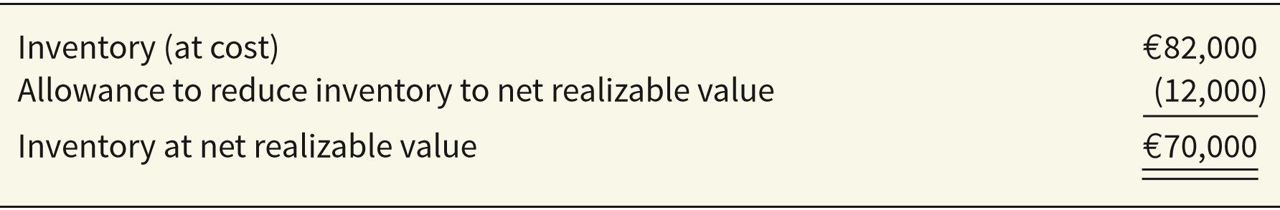
Use of an Allowance 备抵法
Instead of crediting the Inventory account for NRV adjustments, companies generally use an allowance account, often referred to as Allowance to Reduce Inventory to NRV.
Using an allowance account under the loss method, Ricardo SpA makes the following entry to record the inventory write-down to NRV.
Account | Debit | Credit
Loss Due to Decline of Inventory to NRV 资产减值损失——存货减值损失 | 12,000
Allowance to Reduce Inventory to NRV 存货跌价准备 |  | 12,000
ILLUSTRATION 9-7
LO 1
Notes:
Instead of crediting the Inventory account for net realizable value adjustments, companies generally use an allowance account, often referred to as Allowance to Reduce Inventory to Net Realizable Value.
Use of the allowance account results in reporting both the cost and the net realizable value of the inventory.

Slide 17
Use of an Allowance
Partial Statement of Financial Position
LO 1
Notes:
The use of the allowance under the cost-of-goods-sold or loss method permits both the income statement and the statement of financial position to reflect inventory measured at €82,000, although the statement of financial position shows a net amount of €70,000. It also keeps subsidiary inventory ledgers and records in correspondence with the control account without changing prices

Slide 18
单选题
1分
此题未设置答案，请点击右侧设置按钮
Quick Check
Max Company has chosen to use an allowance account. When the cost of goods sold method is used with a perpetual inventory system to adjust cost to “market”, what account is used to record the income effect of valuing inventory at NRV?
A
Inventory
B
Cost of Goods Sold
C
Loss Due to Decline of Inventory to NRV
D
Allowance to Reduce Inventory to NRV
Submit

Slide 19
LCNRV
Recovery of Inventory Loss 存货减值损失转回
Amount of write-down is reversed.
Reversal limited to amount of original write-down.
Continuing the Ricardo example, assume the net realizable value increases to €74,000 (an increase of €4,000). Ricardo makes the following entry, using the loss method.
Account | Debit | Credit
Allowance to Reduce Inventory to NRV 存货跌价准备 | 4,000
Recovery of Inventory Loss 资产减值损失——存货减值损失 |  | 4,000
LO 1
Notes:
In periods following the write-down, economic conditions may change such that the net realizable value of inventories previously written down may be greater than cost, or there may be clear evidence of an increase in the net realizable value. In this situation, the amount of the write-down is reversed, with the reversal limited to the amount of the original write-down.

Slide 20
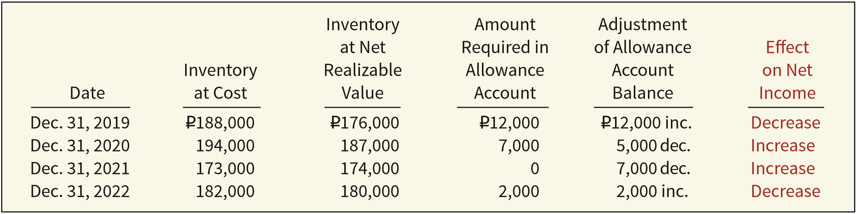
Recovery of Inventory Loss 存货减值损失转回
Allowance account is adjusted in subsequent periods, such that inventory is reported at the LCNRV.
Illustration shows net realizable value evaluation for Vuko Company and the effect of net realizable value adjustments on income.
ILLUSTRATION 9.8
Effect on Net Income of Adjusting Inventory to Net Realizable Value
LO 1
Notes:
If prices are falling, the company records an additional write-down. If prices are rising, the company records an increase in income. We can think of the net increase as a recovery of a previously recognized loss. Under no circumstances should the inventory be reported at a value above original cost.

Slide 21
单选题
1分
Quick Check #3
Under International Financial Reporting Standards (IFRS), which of the following is true regarding inventory write-downs and/or recovery of a write-down?
此题未设置答案，请点击右侧设置按钮
A
Recovery of inventory write-downs is prohibited under IFRS.
B
IFRS requires separate reporting of reversals of inventory write-downs.
C
IFRS requires companies to record write-downs in a separate loss account.
D
All of the choices are correct.
Submit

Slide 22
Evaluation of LCM Rule
LCNRV rule suffers some conceptual deficiencies:
A company recognizes decreases in the value of the asset and the charge to expense in the period in which the loss in utility occurs—not in the period of sale.
Application of the rule results in inconsistency because a company may value the inventory at cost in one year and at net realizable value in the next year.
LCNRV values the inventory in the statement of financial position conservatively, but its effect on the income statement may or may not be conservative. Net income for the year in which a company takes the loss is definitely lower. Net income of the subsequent period may be higher than normal if the expected reductions in sales price do not materialize.
LO 1
Notes:
Many financial statement users appreciate the LCNRV rule because they at least know that it prevents overstatement of inventory. In addition, recognizing all losses but anticipating no gains generally avoids overstatement of income.

Slide 23
LCNRV
P9.1: Remmers SE manufactures desks. The 2019 catalog was in eﬀect through November 2019, and the 2020 catalog is eﬀective as of December 1, 2019. At December 31, 2019, the following finished desks appear in the company’s inventory.
Instructions: At what amount should the four desks appear in the company’s December 31, 2019, inventory, assuming that the company has adopted a lower-of-FIFO-cost-or-net realizable value approach for valuation of inventories on an individual-item basis?
LO 1

Slide 24
LCNRV
Instructions: At what amount should the four desks appear in the company’s December 31, 2019, inventory, assuming that the company has adopted a lower-of-FIFO-cost-or-net realizable value approach for valuation of inventories on an individual-item basis?
LO 1

Slide 25
LCNRV
Instructions: At what amount should the four desks appear in the company’s December 31, 2019, inventory, assuming that the company has adopted a lower-of-FIFO-cost-or-net realizable value approach for valuation of inventories on an individual-item basis?
LO 1

Slide 26
LEARNING OBJECTIVE 2
Explain how to report and analyze inventory.

Slide 27
Presentation and Analysis
Presentation of Inventories
Accounting standards require disclosure of:
Accounting policies adopted in measuring inventories, including the cost formula used (weighted-average, FIFO).
Total carrying amount of inventories and the carrying amount in classifications (merchandise, production supplies, raw materials, work in progress, and finished goods).
Carrying amount of inventories carried at fair value less costs to sell.
Amount of inventories recognized as an expense during the period.
LO 5

Slide 28
Presentation and Analysis
Presentation of Inventories
Accounting standards require disclosure of:
Amount of any write-down of inventories recognized as an expense in the period and the amount of any reversal of write-downs recognized as a reduction of expense in the period.
Circumstances or events that led to the reversal of a write-down of inventories.
Carrying amount of inventories pledged as security for liabilities, if any.
LO 5

Slide 29

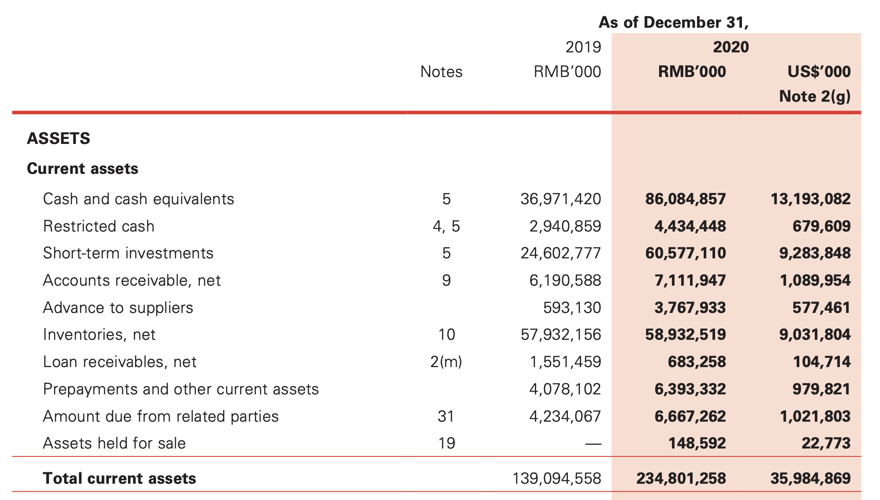

Slide 30
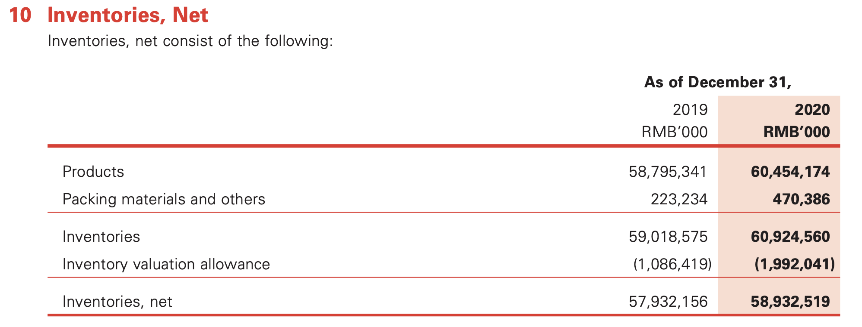
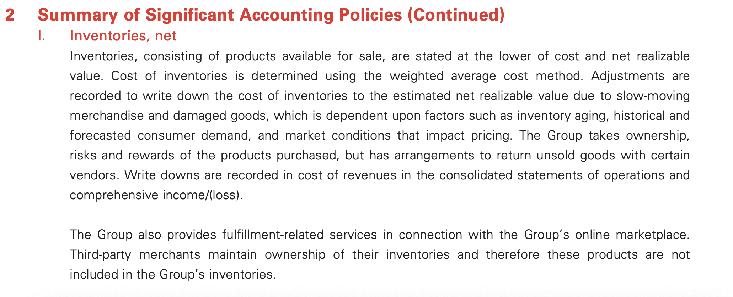

Slide 31

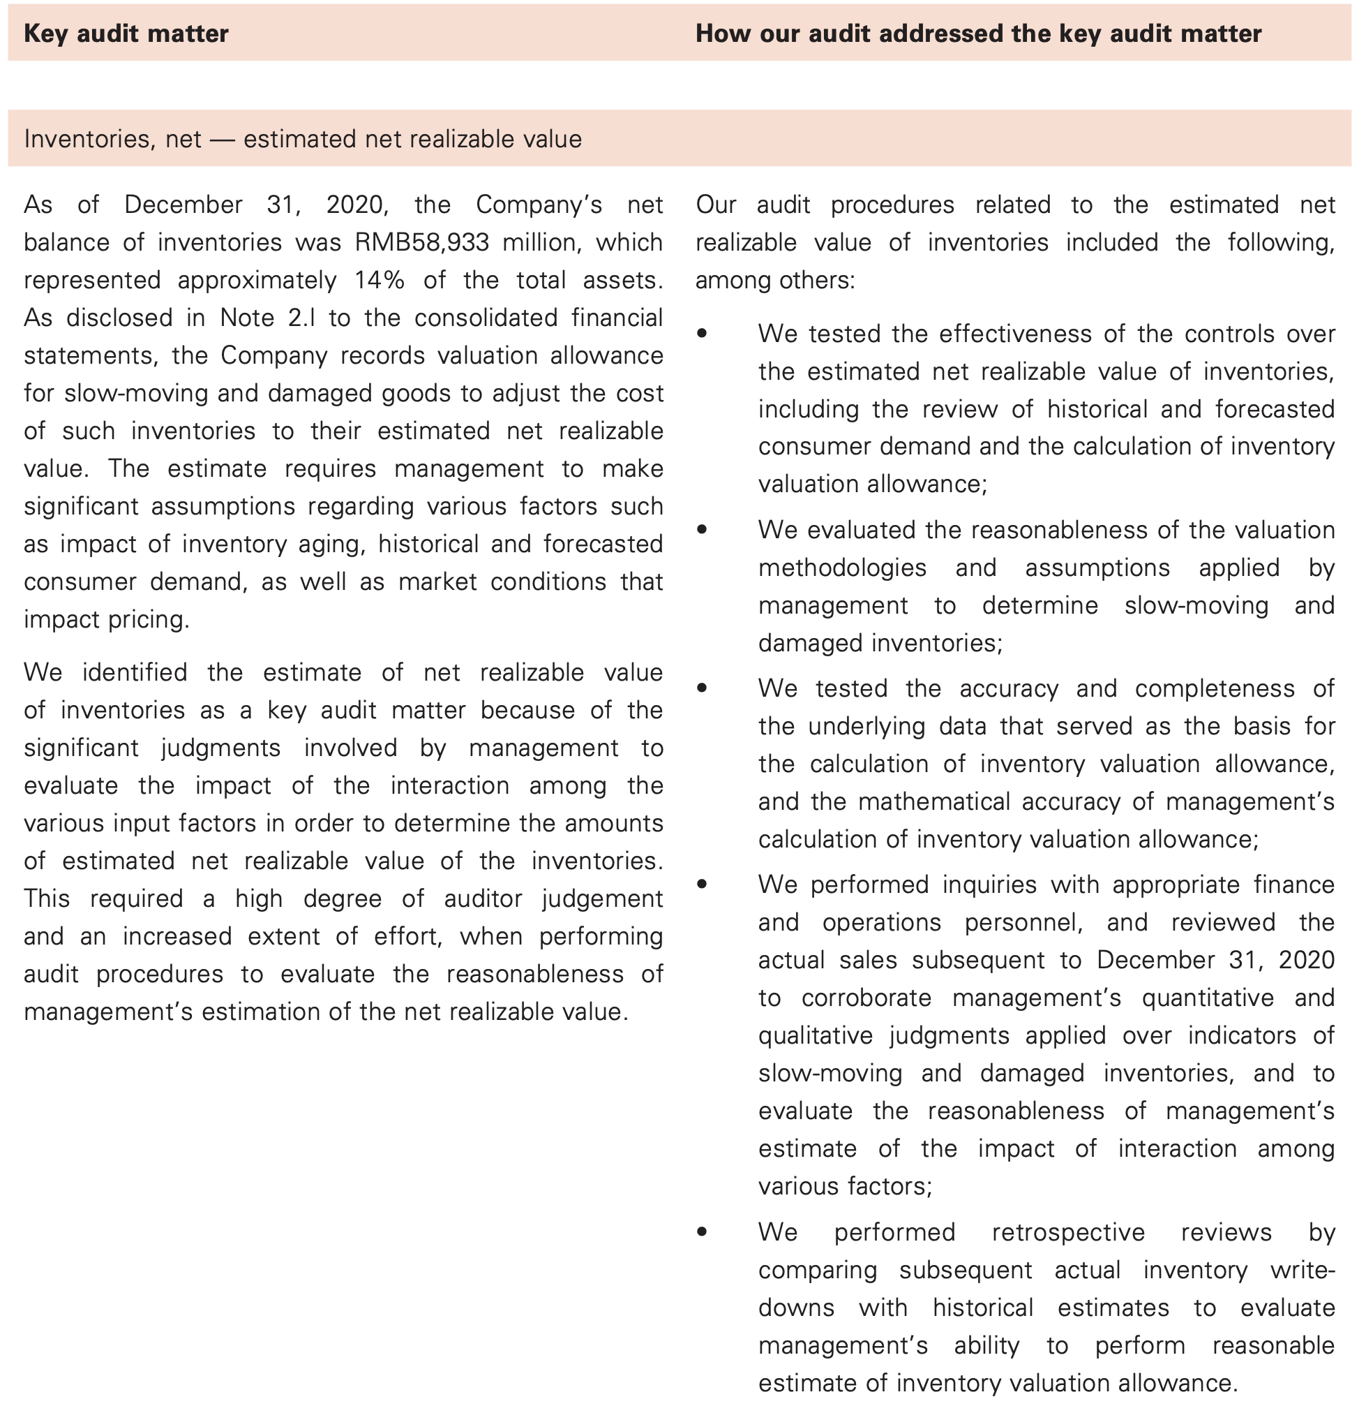

Slide 32

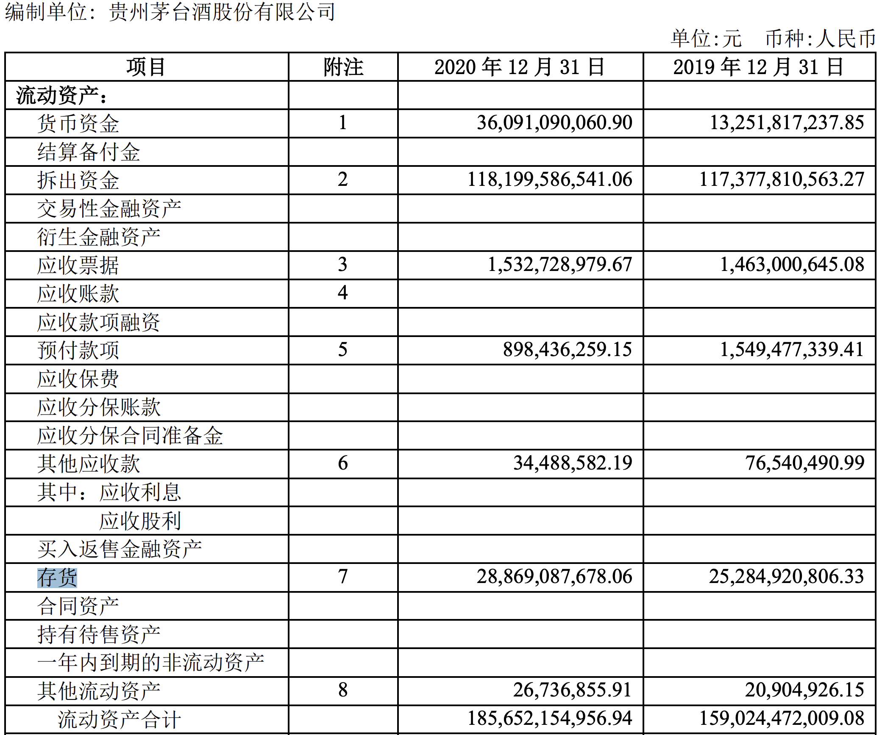

Slide 33


Slide 34
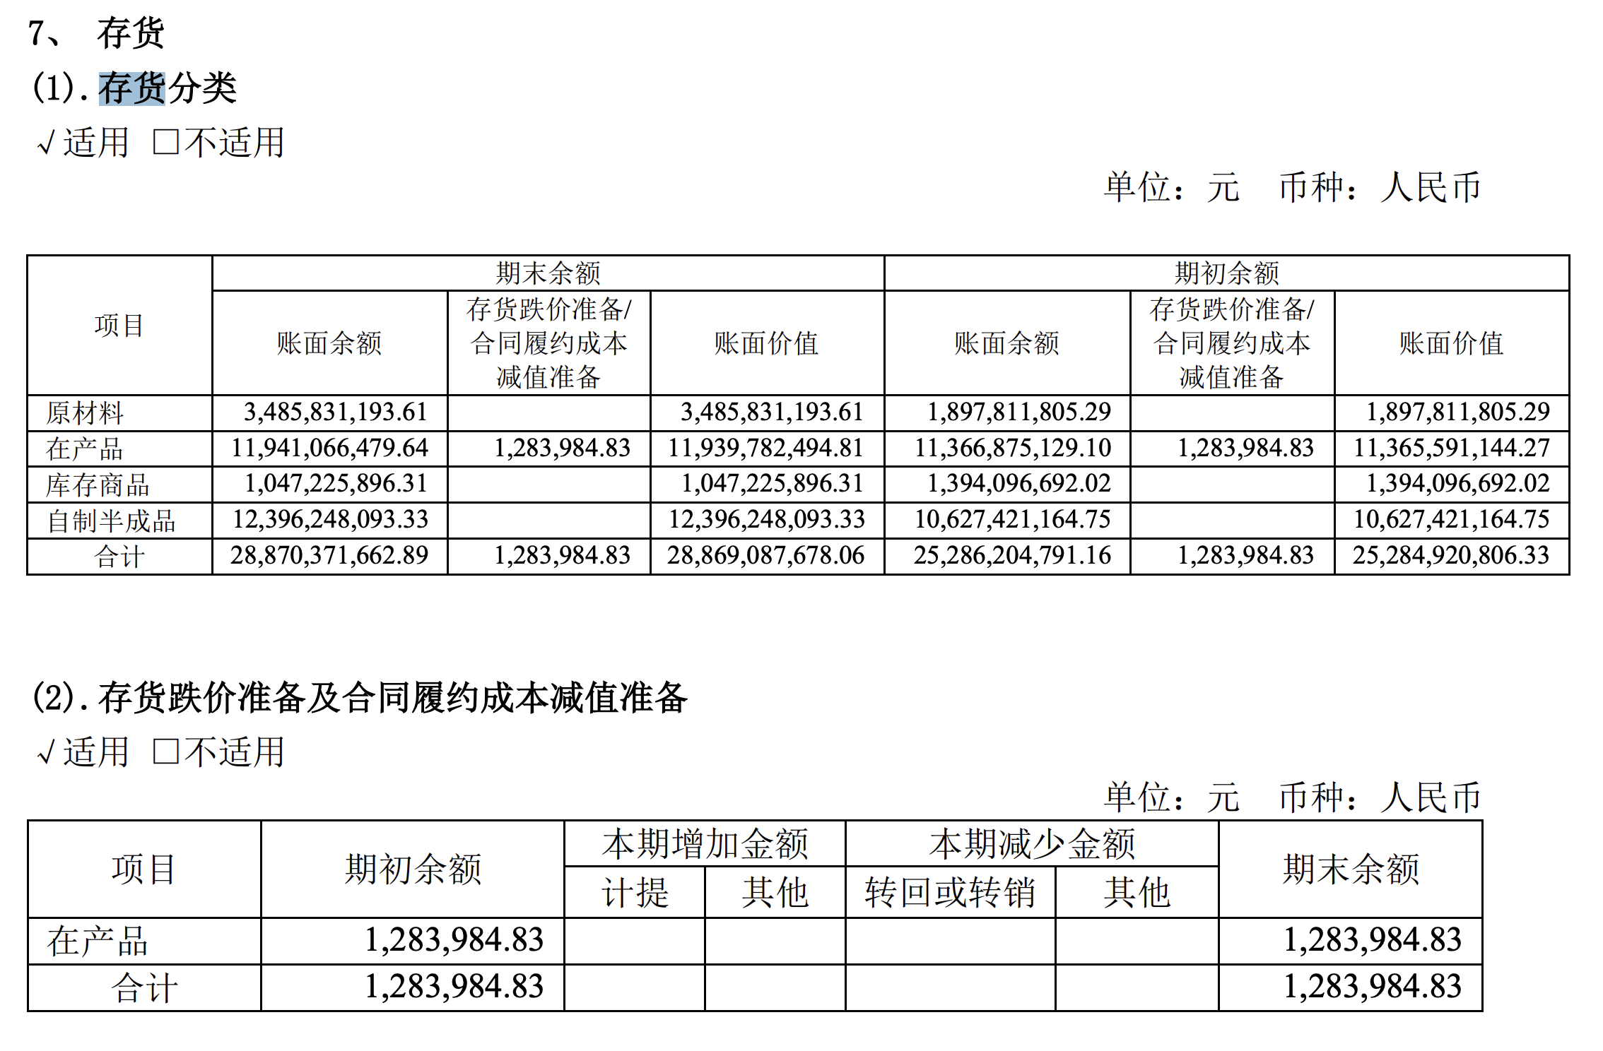

Slide 35


感谢您的参与！
THE HITSZ
SCHOOL OF ECONOMICS
AND MANAGEMENT

